Slide 1


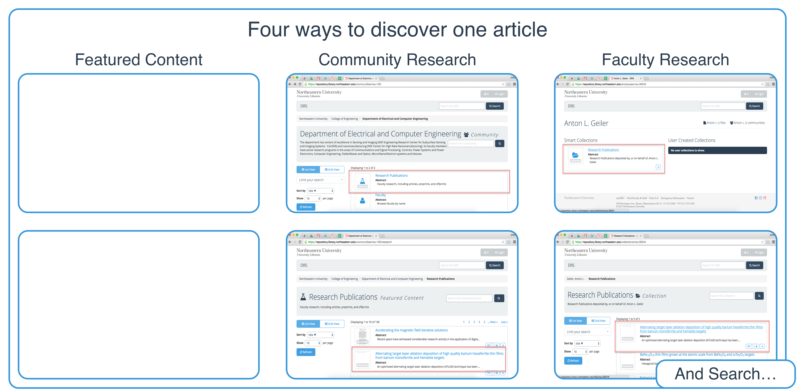
!
sj.sweeney@neu.edu
https://repository.library.northeastern.edu
And search …
Using Communities to Highlight Scholarly Content in Hydra
Sarah Sweeney Digital Repository Manager Northeastern University Library
Notes:
Promotional Slide

Slide 2
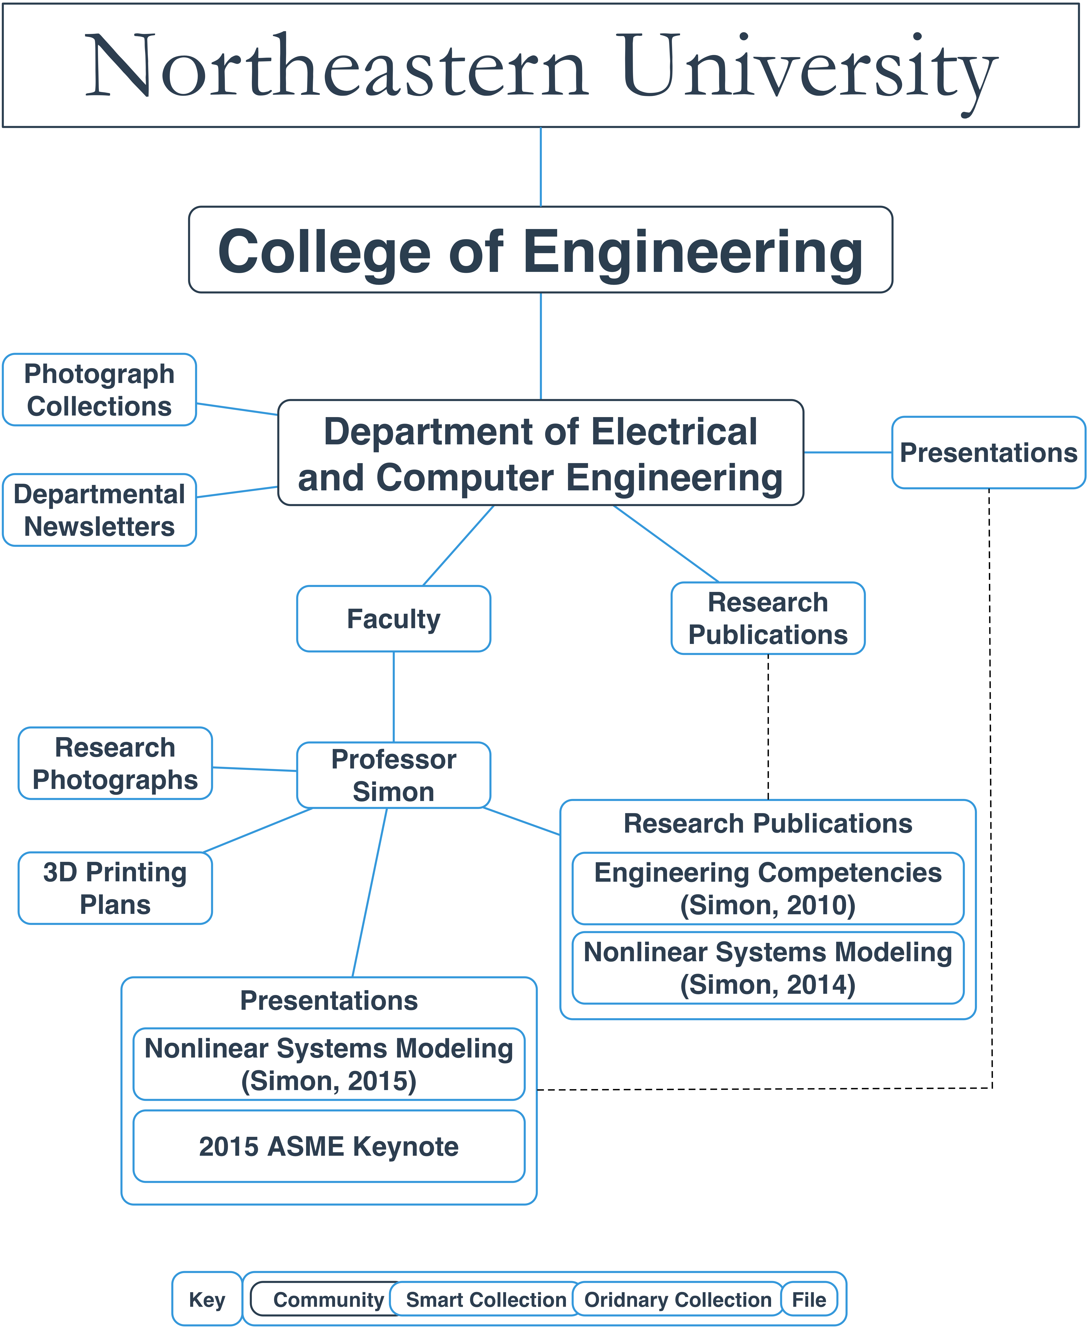
sj.sweeney@neu.edu
https://repository.library.northeastern.edu
Using Communities to Highlight Scholarly Content in Hydra
Sarah Sweeney Digital Repository Manager Northeastern University Library
Notes:
Promotional Slide

Slide 3
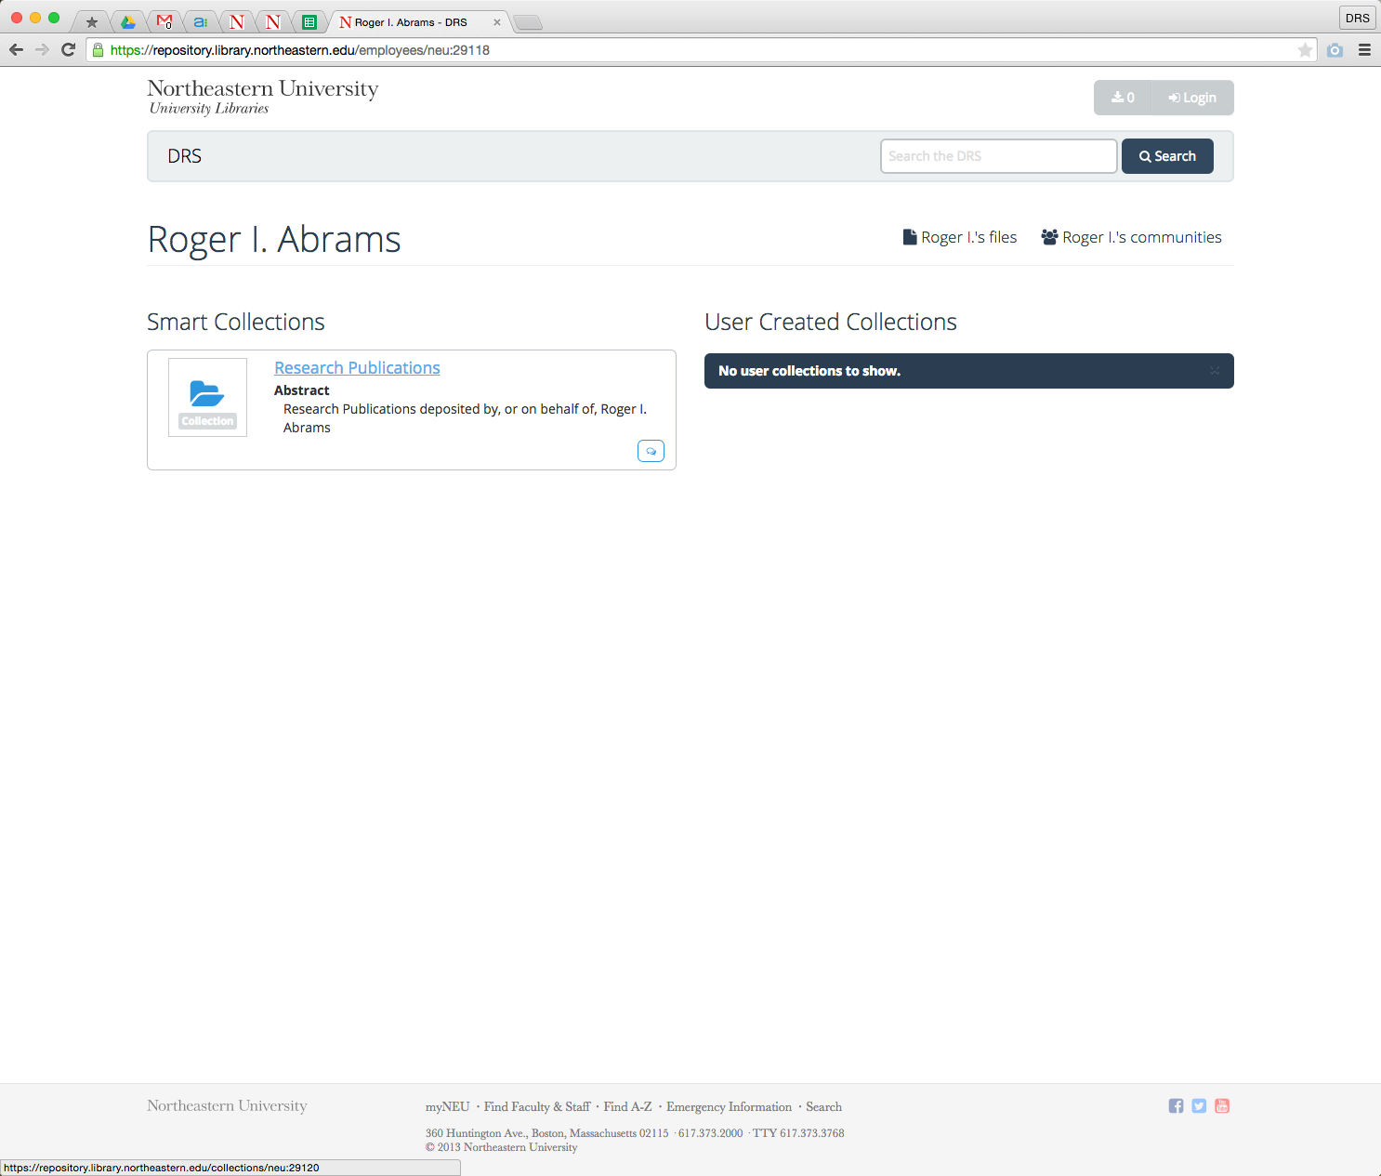
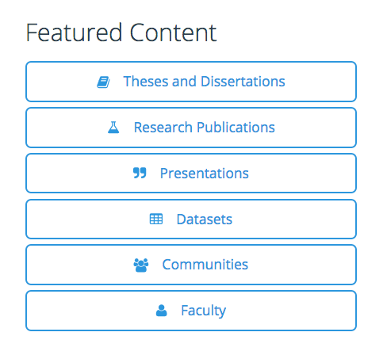
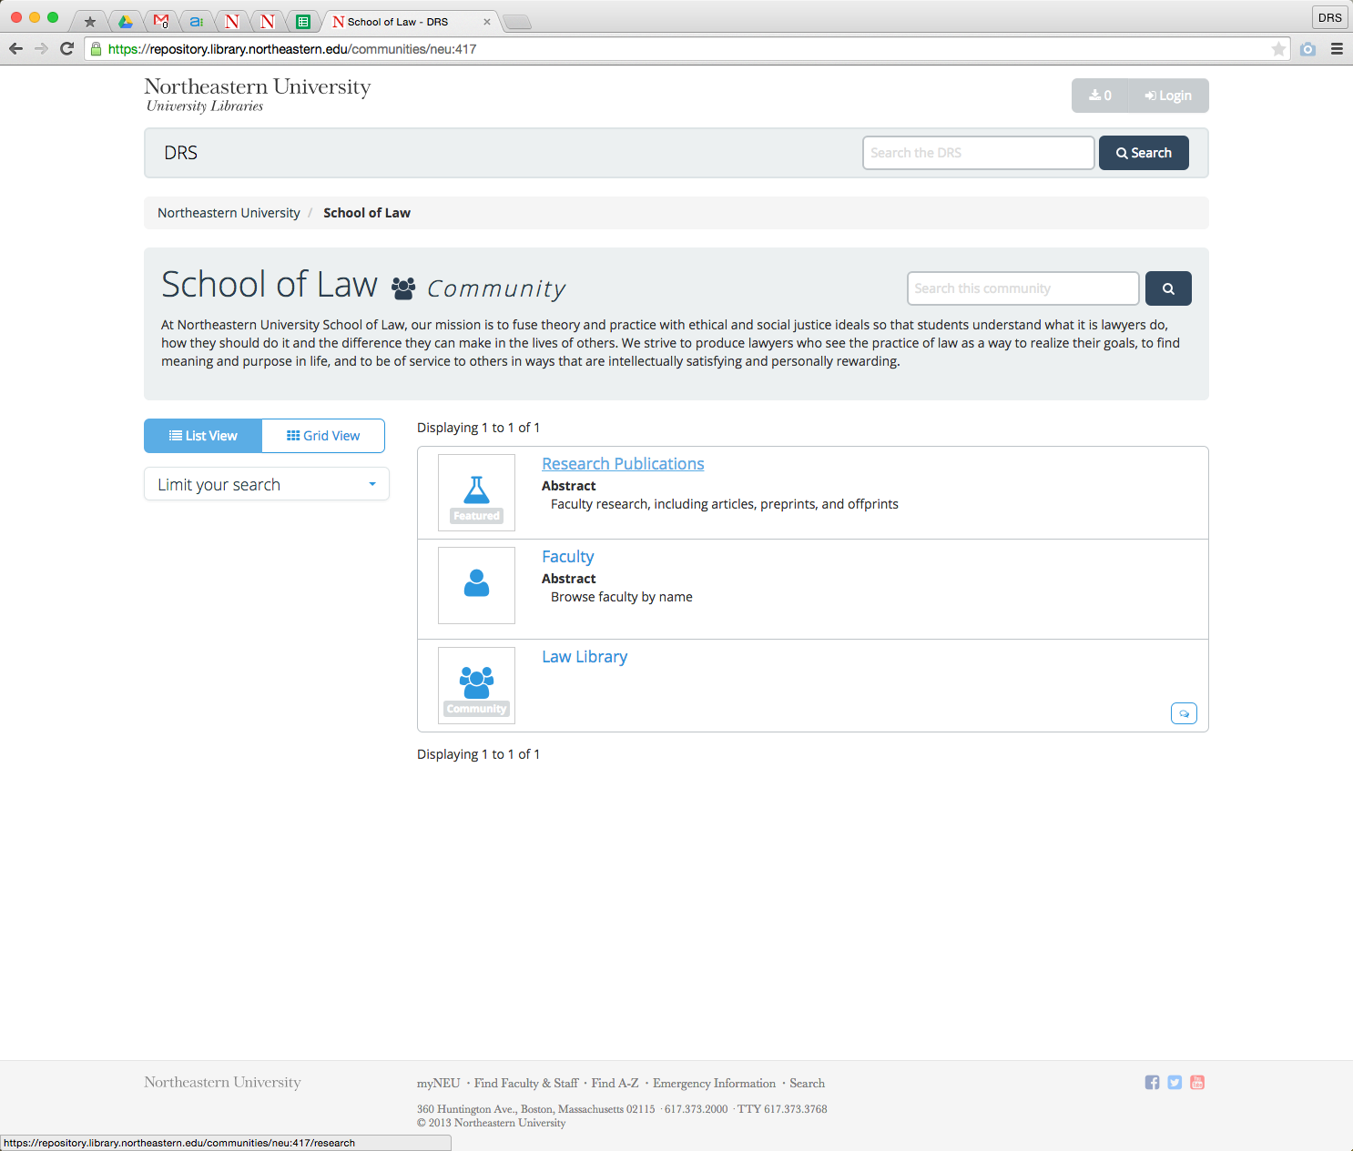
sj.sweeney@neu.edu
https://repository.library.northeastern.edu
Using Communities to Highlight Scholarly Content in Hydra
Sarah Sweeney Digital Repository Manager Northeastern University Library
Notes:
Promotional Slide

